Slide 1

Software project management
Tool assessments, comparison, and suggestions for future development
Author: Muhammad sajad , Muhammad sadiq , khawar Naveed and Muhammad shahid iqbal

Slide 2
Introduction
Name Ayesha Zahoor
Roll No BSCS-F19-M68
Section “B” Morning
Semester 7th CS

Slide 3
Intro to Domain
Software Engineering
Software Engineering tools and technology
Advancement in technology

Slide 4
Year | Author | Methodology | Conclusion
Dec 2015 | Muhammad Sadiq, Amizah Malip,M. Shahid Iqbal ,W.A.M. Othman | We analyze some most commonly referred automated software performance testing tools to verify the practical implementation of purpose matrix. | This paper helps in the development of performance testing tools. Analysis of some most commonly referred automated software performance testing tools from literature to verify the practical implementation of a purposed matrix. In this way, we can identify gaps in other testing tools like static testing, functional testing, test case management etc..
July 2010 | Robert Fabac,Igor Pihir,Danijel Radosevic | The research in this paper was conducted on a sample of prominent Croatian companies regarding the practice of project management software using. | The finding of this research is the established significant correlation between number of employees, number of projects, its budgets, and number of persons involved in a project on one hand and the use of PM support software on the other.

Slide 5
Year | Author | Methodology | Conclusion
24 june,2014 | Francesca Arcelli Fontana, Marco Zanoni, Andrea Caracciolo | In this work wepropose our benchmark platform for design patterns detection,based on a community driven evaluation | we presented a platform helping the design pattern detection community having a way to compare the results produced by the tools and the techniques that have been proposed in the literature.
2Feb,2005 | Graham M. Winch and John Kelsey. | The paper will ﬁrst re-view some of the recent debates on construction project planning. It will then report the results. | We encourage othersto pursue this line of inquiry – planning remains central to construction project management, and its practice deserves more research attention than it currently
August 2011 | Roberto E. Lopez-Herrejon | we describe how to extract the elements of features here. | , we present our experiencein refactoring two systems, one of small size and a largerone publicly available as an open source project. Our workfollowed a three-step refactoring process.

Slide 6
Methodology
Classical and automated tools
While developing software engineering although there are many classical tools but methodology applied here is that automated tools are far better then the classical tools
According to our research the method for achieving the good software is using the automated tools instead if classical tools.

Slide 7
Discussion
There are a huge number of Software Project Management tools which are most likely used in many areas. In our research we present their features which is helpful for any software engineer to choose the right tool.
The list of common tools is mention below.
1. Primavera
2. MS Project
3. GanttProject
4. Redmine
5. BaseCamp
6. dotProject
7. Assembla

Slide 8
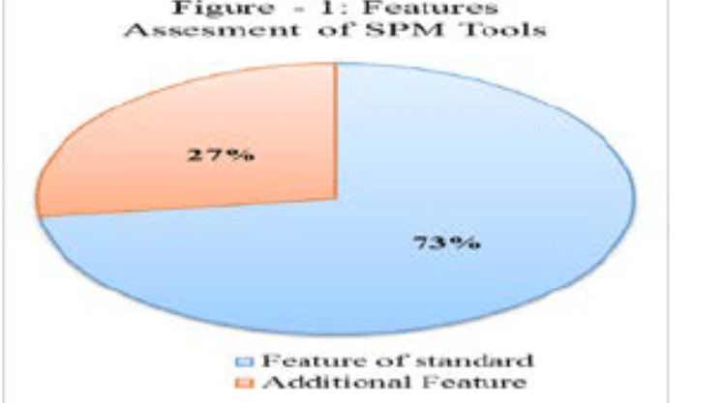
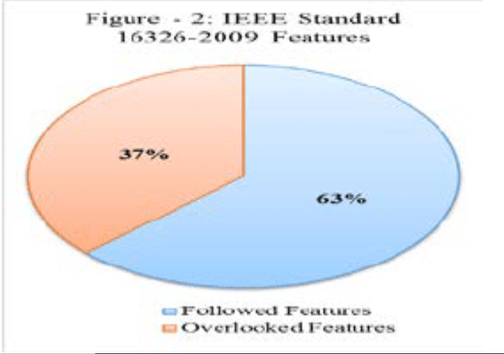
ANALYSIS

Slide 9
conclusion
We analysis the commonly referred software project management tools in a different way.
The features like, Issue tracking, Calendar view , Email notification and task management are mostly repeated in most of the tools. The detail of these additional features not clearly mentioned in the existing standard of project management plan. The details of these features and the additional new features can be added in the standard for upcoming software development tools in future.
Global software development (GSD) can be launched on the basis of finding such kind of additional features of the tools.

